Slide 1
DETECTING SOCIAL DISTANCE BETWEEN PEOPLE
by
A.vigneswari
Reg No: 37110837
Guide Name: Ms. lakshmi priya. K, m.e., (ph.d)

Slide 2
Computer vision
Computer vision is a form of artificial intelligence .
Which can see the environment and understand and analyse like human.
It seeks to automate tasks that the human visual system can do.

Slide 3
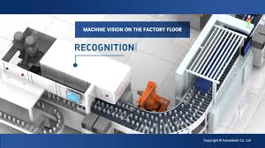
Application
Machine vision
It is the technology which provides automatic inspection and analysis can detect the fault accurately.

Slide 4
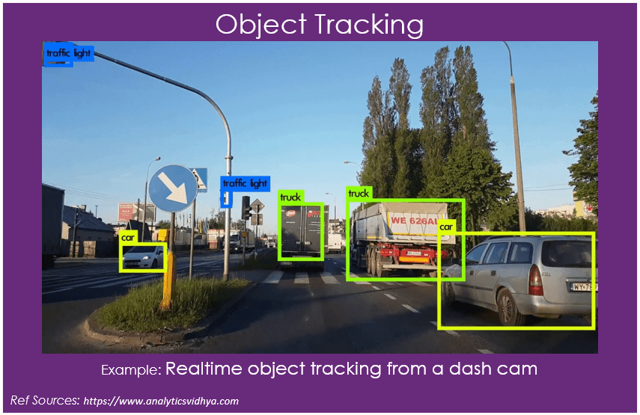
Object Detection And Tracking
It can identify the objects by like human, building and cars by their color,shape as well as motion and can detect and track it.

Slide 5
Application
Human –computer interaction Devices
Autonomous Navigation
Facial Recognition
Motion Tracking
Optical Character Recognition
Image Restoration

Slide 6
Computer vision Pipeline
Computer vision Pipeline
Image Acquisition
Image
processing
Decision making
Image
Analysis

Slide 7
I implemented one of the applications of computer vision which is very intersting and necessary.
DETECTING SOCIAL DISTANCE BETWEEN PEOPLE

Slide 8
objective
This technique is to detect wheather the people are maintaing social distance between them from a recorded video by indicating the position of people from each other.

Slide 9
Tools used
My project is build using
Opencv
Python
Some packages
cv2
Numpy
Imutils

Slide 10
opencv
Stands for ‘open source computer vision’
Library of function for real-time computer vision
Developed in c++
Supports python,java,MATLAB,OCTAVE

Slide 11
Input:
Video file name or the path of the file in which we want to detect social distance.
Output:
Video with bounding red rectangular contour if there is no social between them else with green contour indicates that they are maintaing social distance.

Slide 12
Steps Involved
Extracting the video from file by giving the video filename or the path as a input.
Then with the help of object tracking procedure human who are in motion are detected and tracked.

Slide 13
Then by using centroid algorithim one of best algorithims in object tracking distance between each other is calculated by using euclidean distance calculation.
Then the calculated distance will be compared with the given range based on that comparison result will be displayed.

Slide 14
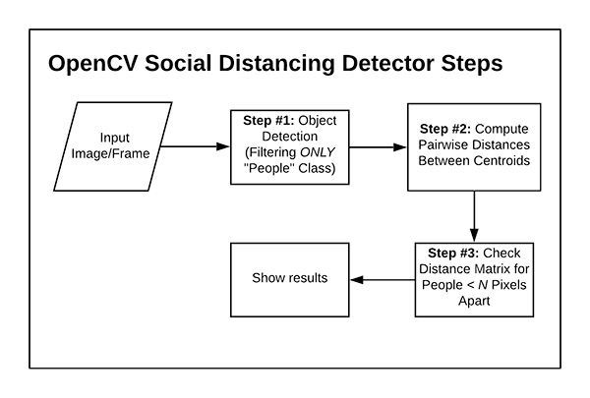
FLOWCHART FOR detecting

Slide 15
After Execution
After running the program the following output will be displayed.
The video with the combination of red and green contour red contour indicates that they are voilating the social distance rule.
Then the program will stop its execution if we press ‘q’, it can be changed according to user.

Slide 16
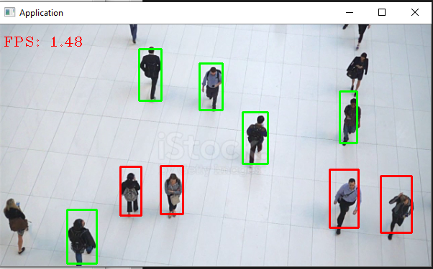
SOCIAL DISTANCE DETECTED

Slide 17
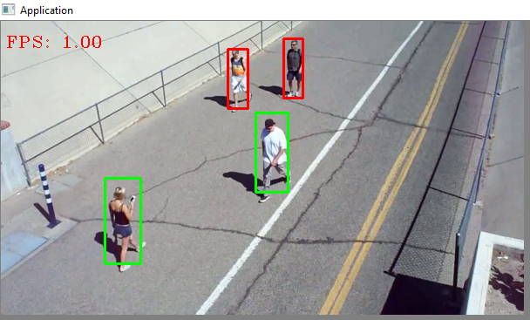

Slide 18
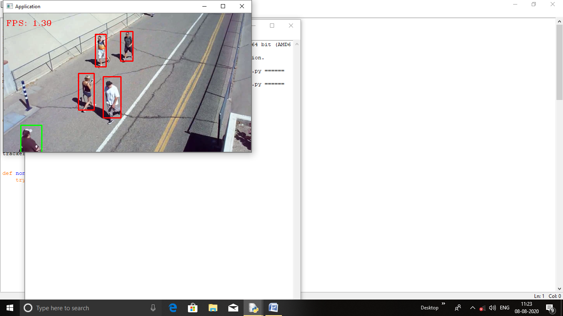

Slide 19
Conclusion
By this project we would be able to find people who have not followed social distancing and one who have followed.By this way we could pick out the people who had contact with the affected one.

Slide 20
References
PYTHON : http://www.imarticus.org
COMPUTER VISION http://www.realpython.com
MOTION DETECTION http://www.pyimagesearch.com
OBJECT TRACKING http://www.imageannotation.ai
COMPUTER VISION A modern approach:Forsyth and ponce,pearson

Slide 21
My sincere thanks to the guide mrs lakshmi priya. k, m.e(ph.d) and to the head of the department.

